Slide 1

Companies Bankruptcy Forecast
Gropu-4
Ambika Saini Prachi Tripathi Shweta Pandey

Slide 2
Problem statement
Bankruptcy prediction has been a subject of interests for almost a century and it still ranks high among hottest topics in economics. The aim of predicting financial distress is to develop a predictive model that combines various econometric measures and allows to foresee a financial condition of a firm.
The purpose of the bankruptcy prediction is to assess the financial condition of a company and its future perspectives within the context of long term operation on the market (Zieba, et al., 2016).

Slide 3
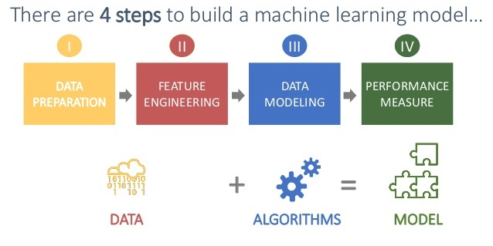
Steps For Machine Learning Models

Slide 4
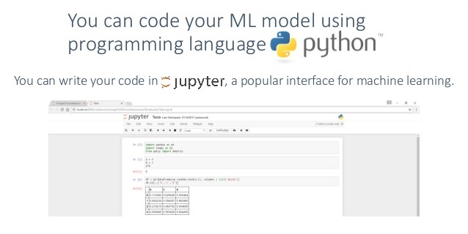
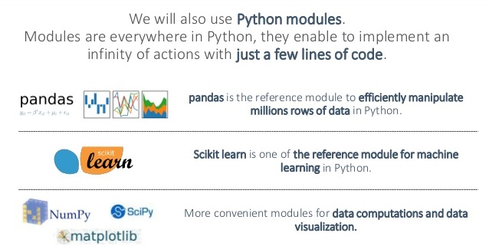
Tools Used

Slide 5
Steps Performed in the Data :
Step 1 : Importing the Required Libraries.
Step 2 : Reading the csv file.
Step 3 : Splitting my data into feature and target variable.
Step 4 : Analyzing the correlation missing values, outliers.
Step 5 : Analysis data distribution, data Skewness.
Step 6: Data Imputation in the missing values.
Step 7 : Feature Scaling, Feature Selection,
Step 8 : Splitting the data into test and train.
Step 9 : Applying the models.
Step 10 : Analyzing the performance metrics.

Slide 6
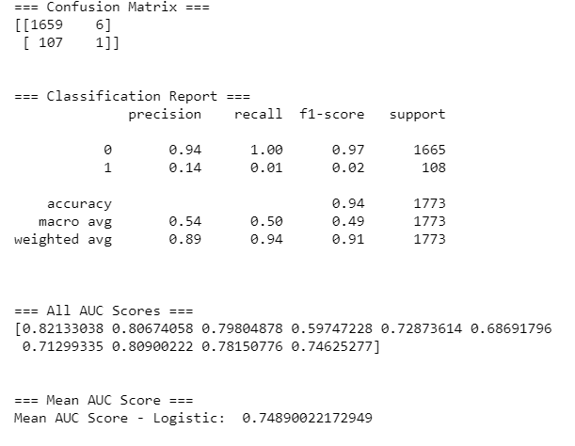
Used Models
Logistic Regression

Slide 7
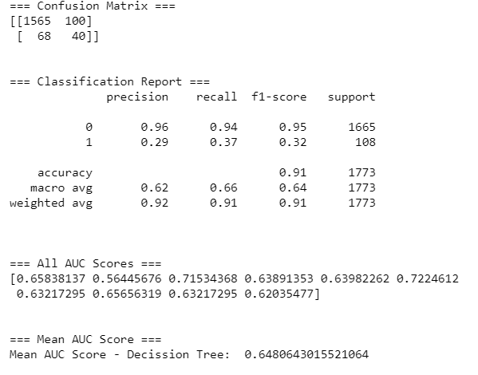
Decision Tree

Slide 8
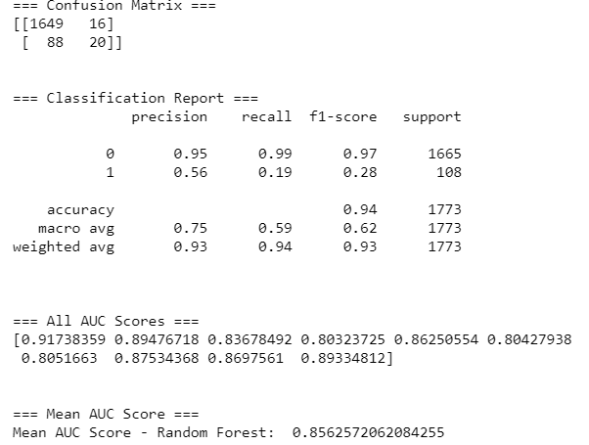
Random Forest

Slide 9
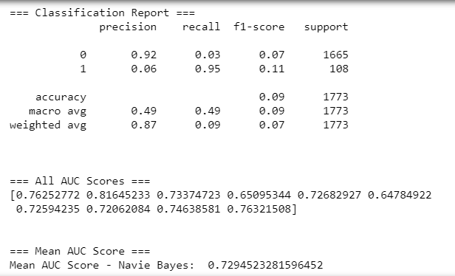
Naive Bayes

Slide 10
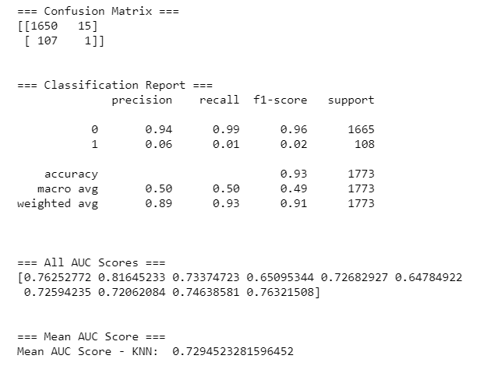
K Nearest Neighbour's

Slide 11
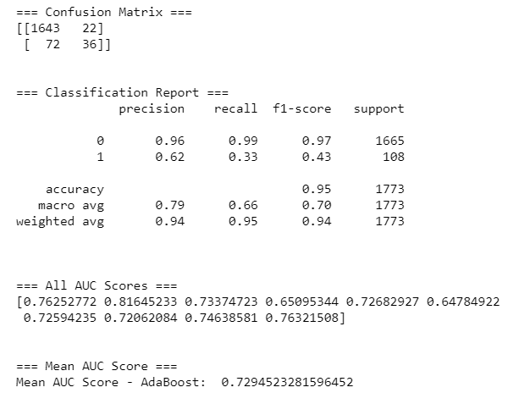
AdaBoost

Slide 12
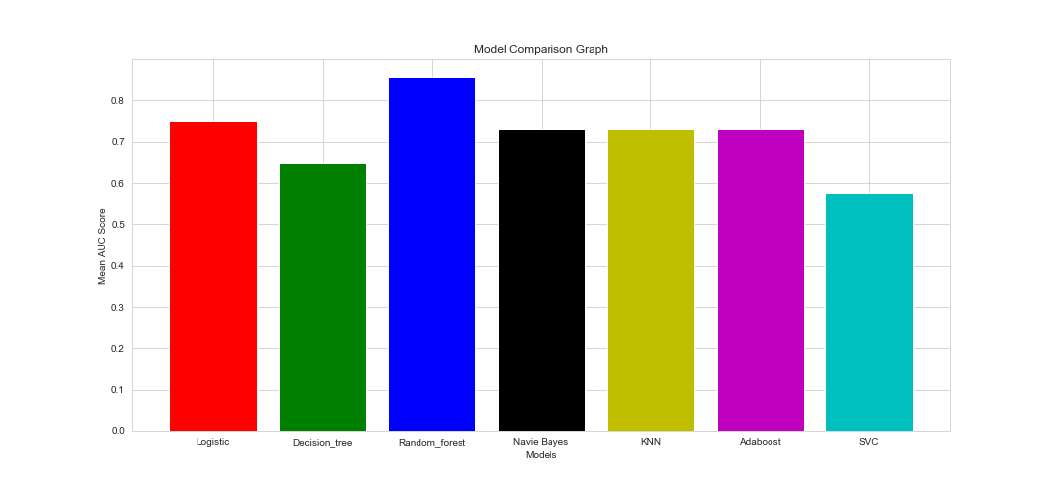
Model Comparison with Mean AUC Score

Slide 13
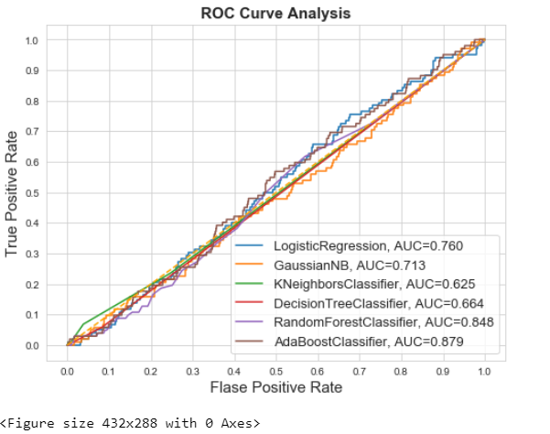
Comparison Of ROC Curve Analysis

Slide 14
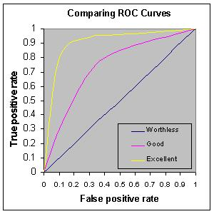
Identification of the best model
The accuracy of the test depends on how well the test separates the groups. Accuracy is measured by the area under the ROC curve. An area of 1 represents a perfect test; an area of .5 represents a worthless test. A rough guide for classifying the accuracy of a diagnostic test is the traditional academic point system:
.90-1 = excellent (A)
.80-.90 = good (B)
.70-.80 = fair (C)
.60-.70 = poor (D)
.50-.60 = fail (F)

Slide 15
Identification of the best model
We are selecting the best model for our dataset is :
Random Forest with the
Mean AUC Score - Random Forest: 0.84

Slide 16


